Slide 1
EPI-PDL pigs for PK-PD studies
SGPlus & ANARA AB

Slide 2
What is exocrine pancreatic insufficiency (EPI/PDL) ?
An inability to properly digest food due to a lack of digestive enzymes produced by the pancreas

Slide 3
EPI resulted in an slight increased intestinal permeability as compared to un-operated pigs indicating an impaired gut barrier function
The general functional adaptation to EPI has similar pattern and is age independent
However some adaptive mechanisms and capacity of gut for feed digestion/absorption is age related and dependent on the maturity of the gut and, possibly, on gut-associated immune system

Slide 4
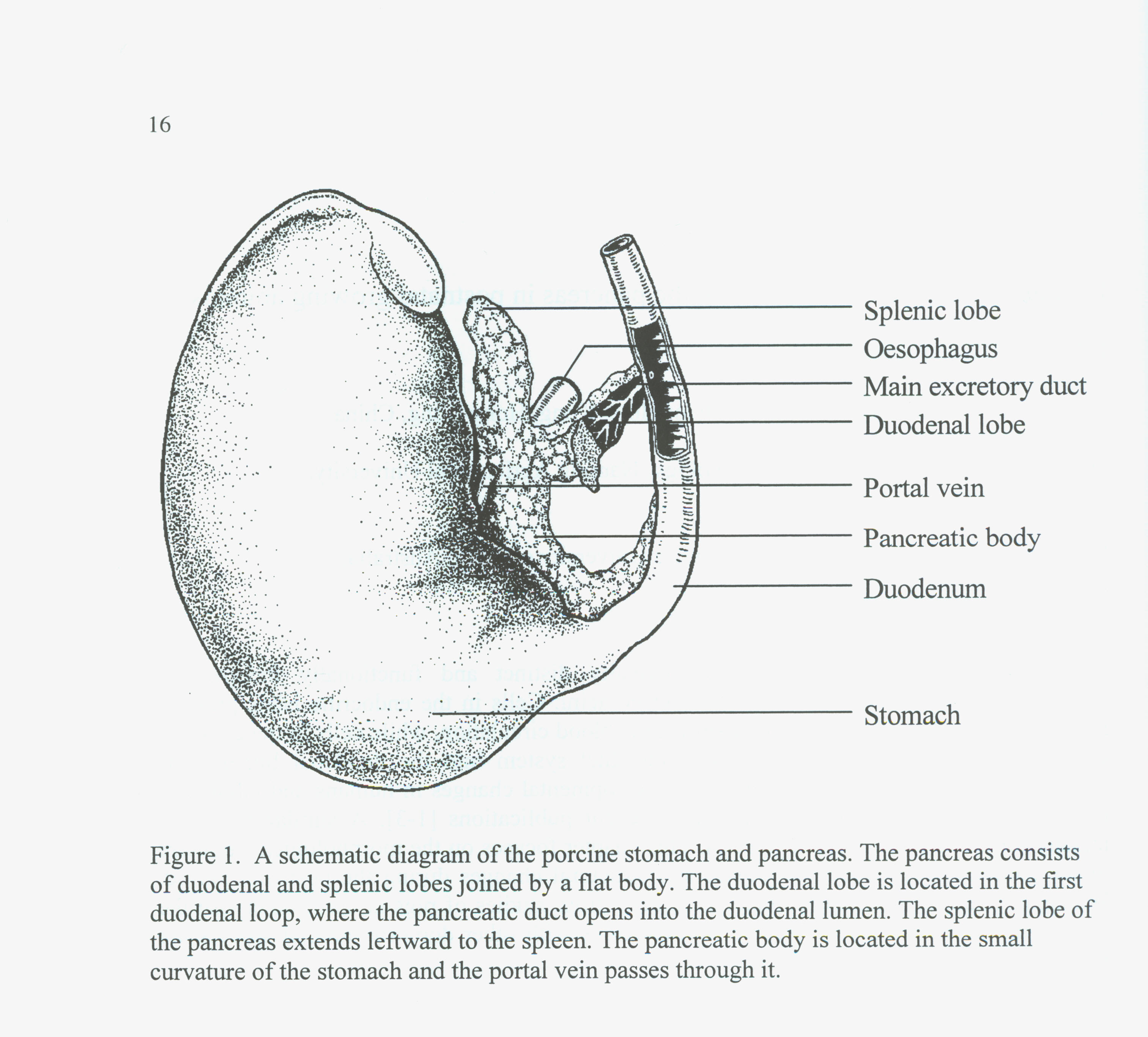
Pancreatic duct ligation in pigs
15 minutes surgery

Slide 5
Growth of pigs during experiment
EPI weaners
EPI growers

Slide 6
Result of EPI/PDL

Slide 7
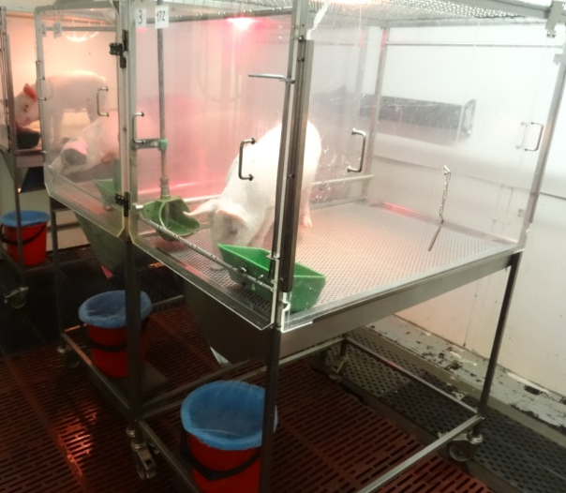

Slide 8
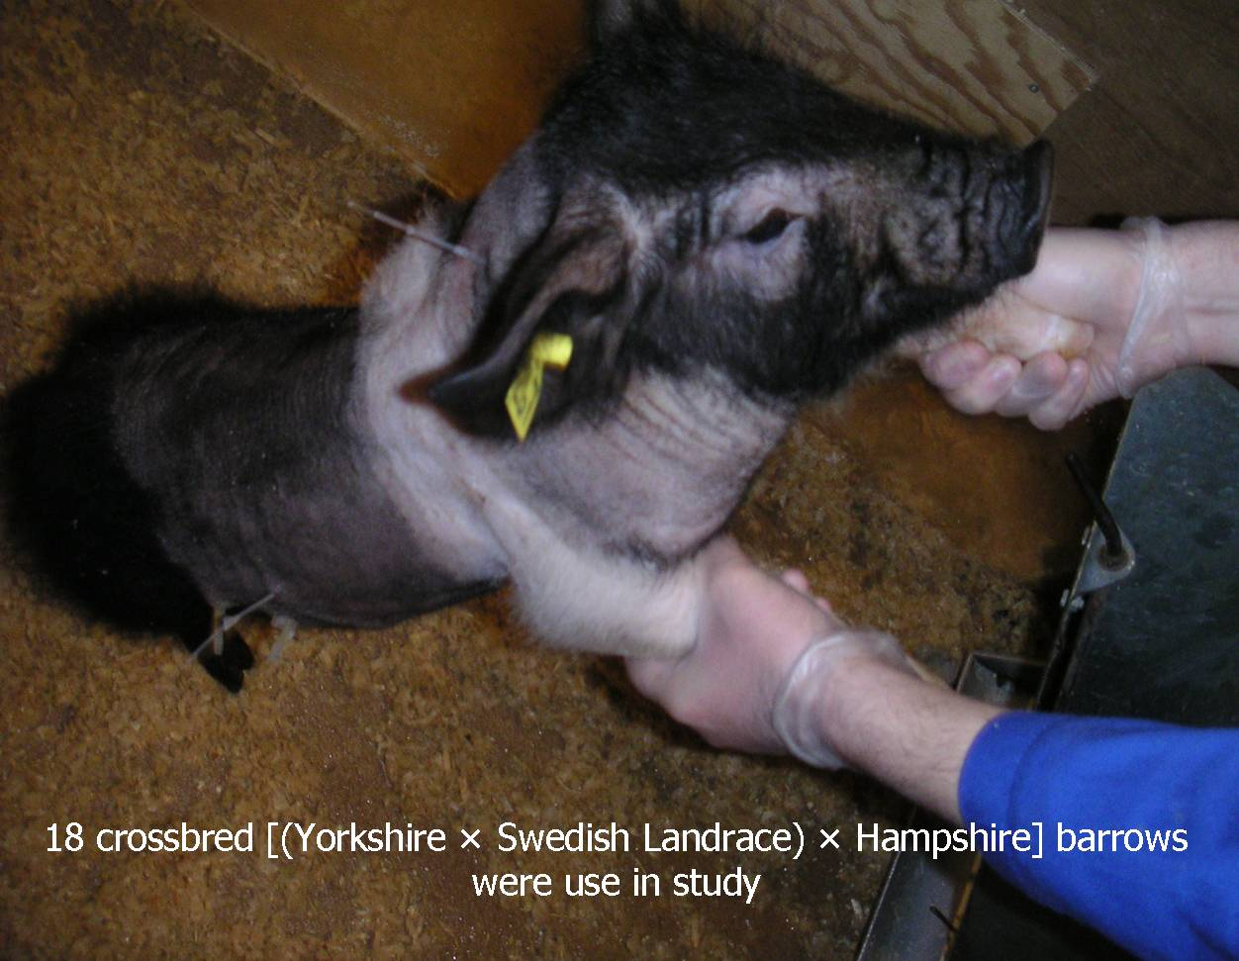
Animals

Slide 9
